Slide 1
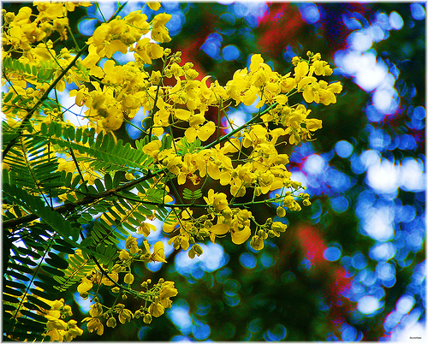
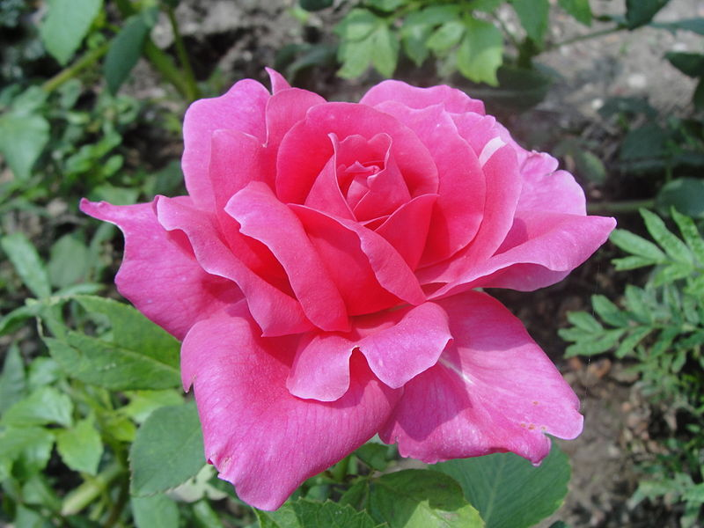
Welcome

Slide 2
Teacher’ Information
Moqbul Hossain
Lecturer in English
Iqbal Memorial Degree College
Dagonbhuiyan, Feni.

Slide 3
Learning Outcome
After this lesson students will be able to say about water pollution.
Mention the factors responsible for water pollution
Explain the process of water pollution

Slide 5
Eleventh Class
English 1st paper
Unit 6 ,lesson 2
Water pollution

Slide 6
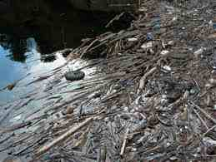
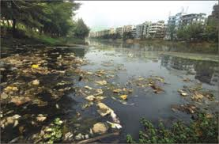
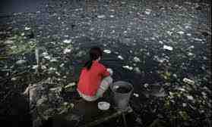
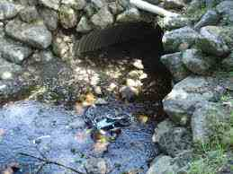
Pollution

Slide 7
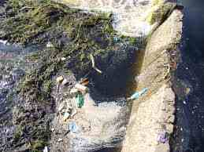
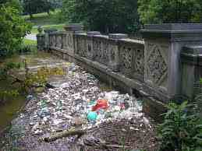
Water ,another vital element of the environment , is polluted in many ways.
filth
rubbish

Slide 8
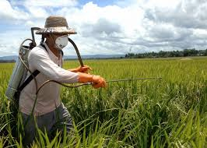
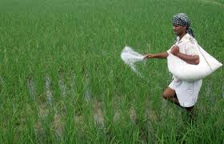
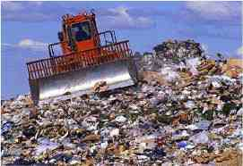
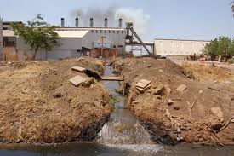
insecticide
fertilizer
Waste from mills
waste

Slide 9
Farmers use chemical fertilizer and insecticides in their fields.

Slide 10
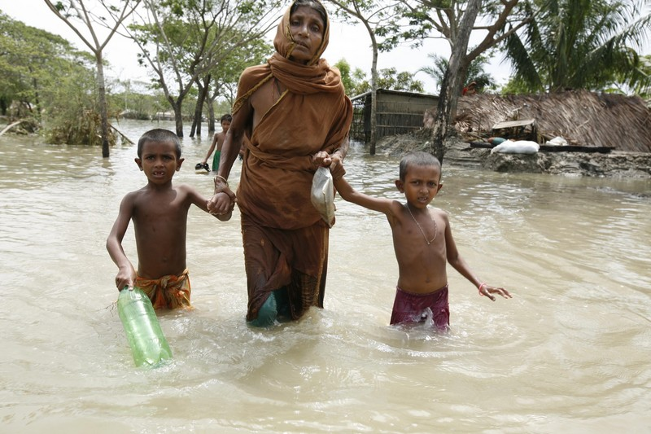
flood

Slide 11
When rain and floods wash
away some of these
chemicals ,they get mixed
with water in rivers ,canals
and ponds.

Slide 12
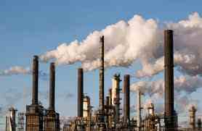
factfories

Slide 13
Mills and factories also throw their poisonous chemicals into rivers and canals.

Slide 14
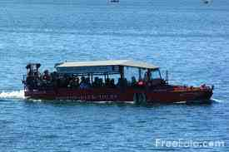
Water vehicles

Slide 15
Water vehicles also pollute rivers by dumping oil, food waste and human waste into them.

Slide 16
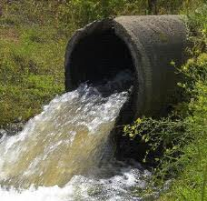
Unsafe drain

Slide 17
Insanitary latrines and unsafe drains standing on river and canal banks are also responsible for further pollution.

Slide 18
Thus ,water is contaminated by various kinds of waste and filth.

Slide 19
Single task
Say true or false; if false give the correct information
a) Water is not polluted at all.
b) Man does not pollute water.
c) Unsafe drains pollute water.
d) We must stop water pollution.
e) We should not be conscious of water pollution

Slide 20
Pairs work
Name five sources of water pollution.
a)Chemical fertilizer
b)Industrial discharge
c)Oil from water vehicles
d)Food waste e)Human waste

Slide 21
Group Work
Find out the ways of reducing water pollution.

Slide 22
Evaluation
a) How does man pollute water?
b) How farmers contribute to water pollution?
c)How do chemicals get mixed with water?
d)What drains pollute water?
e)How do water vehicles pollute water?

Slide 23
Home Work
Write a short paragraph on water pollution

Slide 24
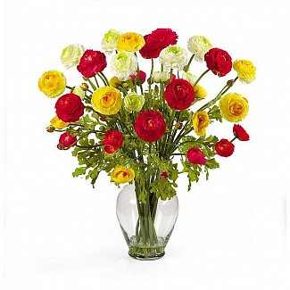
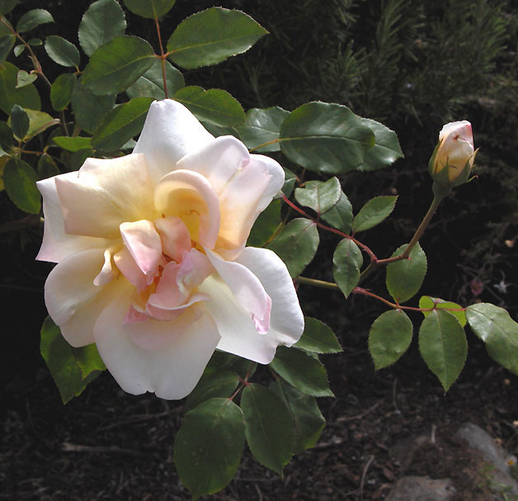
Thank you

